Slide 1
607 Project 3: What are the top data science skills?
Team SMZC
Stephanie Roark, Mike Groysman, Zach Herold, & Chad Bailey

Slide 2
Business Problem & Initial Exploration
Business Problem
  Which are the most valued data science skills?
Initial Exploration
  General and broad web searches around data science skills
  Sites of known value (Kaggle, Quora)
  Looking for existing work for context
  Looking for raw data

Slide 3
Data Used
4 tables
    ds_user_profiles
        Web scrape from LinkedIn of profiles self-identifying as Data Scientists
    ds_job_posting_skills & ds_job_posting_software
        pulled from a Kaggle project
        the original author scraped from multiple job posting site
    Skills
        Web scrape from Indeed
        Attempting to reproduce and validate
        Also looking for additional details

Slide 4
Team Member Roles
Task | Team Member(s)
Setup team tools | Zach Herold, Chad Bailey
Collect data & context resources | Mike Groysman, Zach Herold
Data storage (SQL) | Steph Roark
Documentation | Steph Roark, Mike Groysman
Analysis | Chad Bailey, Zach Herold
Review & revise final products | All
Presentation | All

Slide 5
Refined Questions
What are the top data science skills identified by data scientists?
What are the top data science skills identified by employers (via job postings)?
Do data scientists and employers agree on what at the top data science skills?

Slide 6
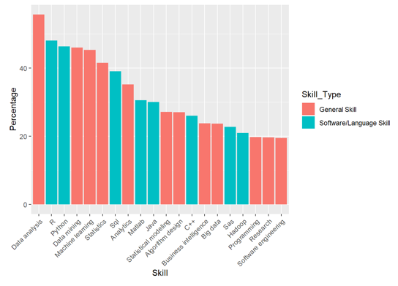
Conclusion Graphics
Top Skills Identified by Data Scientists, via LinkedIn Profiles

Slide 7
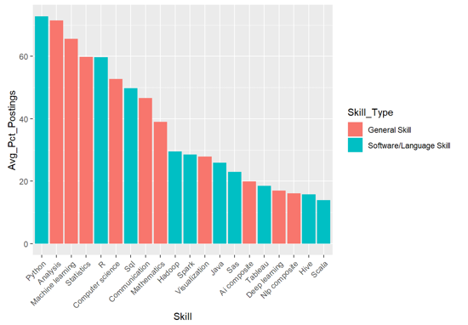
Conclusion Graphics
Top Skills Identified by Employers,
via Job Postings

Slide 8
Conclusion Summary
Skills identified by both Data Scientists and Employers
    Data Analysis
    R
    Python
    Machine Learning
    Statistics
    SQL
Communication
    Missing from Data Scientist profiles
    Among Employers’ top 10 skills
    We found it paramount for the success of this project

Slide 9
Challenges
Finding team members and forming a group
Initial setup of team tools and spaces
Defined tasks but didn’t assign specific individuals to each task
    This meant some tasks were duplicated by multiple individuals
Learning new tools
    R, MySQL, Slack, and GitHub
Multiple time zones
    Communication

Slide 10
Possible Further Analysis
Using the data to create an HR tool to screen applications
Comparative rank analysis of skills
Gather and incorporate salary data
Change of “top” skills overtime

